Slide 1



Strategy
Home on the Hill
September 23, 2018

Slide 2
STRATEGIC PLAN FOR HOME ON THE HILL
Agenda
Home on the Hill Background and Problem Definition
Project Approach
Data Findings
Strategic Recommendations
Roadmap
Questions

Slide 3
Home on the Hill Background and Problem Definition

Slide 4


HOME ON THE HILL PROBLEM DEFINITION
Home on the Hill | Background and Problem Definition
Small but resourceful organization with a wide reach
Home on the Hill (HOH) provides support to patients and families who experience severe mental illness
Established in 2011, HOH currently has seven Board members, small, passionate, enthusiastic, operates primarily in Richmond Hill and Vaughan
Vision and Mission: to provide a caring home environment that projects a sense of belonging, growth and security for all persons, by changing the way people are supported (to address gaps/flaws in current mental health system)
Current services include patient activity/therapy programs (art, music, cooking, yoga, vocational training), family/caregiver support/respite group, supportive housing (currently one tenant with part-time housing is supported), and public education/outreach through the Robert Veltheer Lecture Series on Mental Illness
Problems: lack of robust short-term and long-term strategies (have had recent significant changes to Board), Board members could improve alignment on strategic priorities/operations/expectations, concerns about financial sustainability and maintaining a meaningful and effective impact

Slide 5

HOME ON THE HILL PROBLEM DEFINITION
Home on the Hill | Project objectives
A 3 step approach to helping Home on the Hill
Gap Analysis
Assessing Home on the Hill by collecting and analyzing data from its clients, caregivers and professionals who interact with it, as well as interviews with Board members
Strategic Recommendations
Synthesizing all of the data and insights collected, proposing strategic recommendations around goals, objectives & performance goals and revised vision and mission statements.
Suggested Recommendations
Proposing suggested revisions to existing vision, mission and principles statements – as a starting point to work from.
Notes:
Bruno: “performance goals. and revised vision and mission statements.” into objectives & performance goals and revised vision and mission statements.

Slide 6
Project Approach

Slide 7

PROJECT APPROACH
Project approach |Overview
Overview of analysis used to come up with a set of recommendations
Desk Review
Surveys
Data Analysis
Recommendations
Workshop Elicitation
Financial Analysis
Robert Veltheer Lecture
Competitive analysis
Participant Survey
Board Member Interviews
Statistical Approach
Qualitative Approach
Data Results
Strategic Recommendations
Roadmap
Financial analysis
Robert Veltheer lecture survey
Competitive analysis
Participants survey
Board interview
⤑ Performed financial analysis on financial statements going back to 2012
⤑ Focus groups held after attending Robert Veltheer lecture on ADHD as well as survey distributed to attendants
⤑ Analyzed and benchmarked non-profit organizations (regionally, nationally and internationally)
⤑ Distributed to individuals affected by mental illness, their caregivers and mental health professionals.
⤑ Obtained a response rate of 20.1%
⤑ Conducted individual board interviews with current members of the Home on the Hill Board

Slide 8

PROJECT APPROACH
Project approach |Overview
Overview of our approach towards building the strategic recommendations
Data Analysis phase
Strategic Recommendations Approach
Financial analysis
Assets
Robert Veltheer lecture survey
Tangible & Intangible
+
$$=$$
Core Competencies
“HoH Advantage”
Board interview
Community
Assets + Skills
Clients, complementors, competitors and hospitals
Skills
Participants survey
Capabilities & processes
Competitive analysis

Slide 9
Data Findings

Slide 10
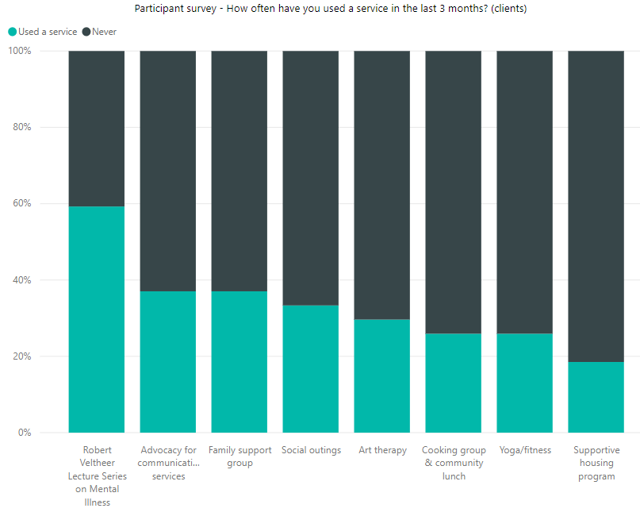
DATA FINDINGS
Perception of outreach by clients
Frequency of use and likelihood of return
Recommendation
The Robert Veltheer lecture series was mentioned consistently within the survey as a service which people were very likely to use, and people who attended the lectures were also much likelier to attend other Home on the Hill services (highly correlated).
Lecture series found to be important for HOH’s visibility in the community (as confirmed by Professionals who believe that Home on the Hill is best recognized for its lectures), which is acknowledged by Board members to support the long-term vision of success

Slide 11
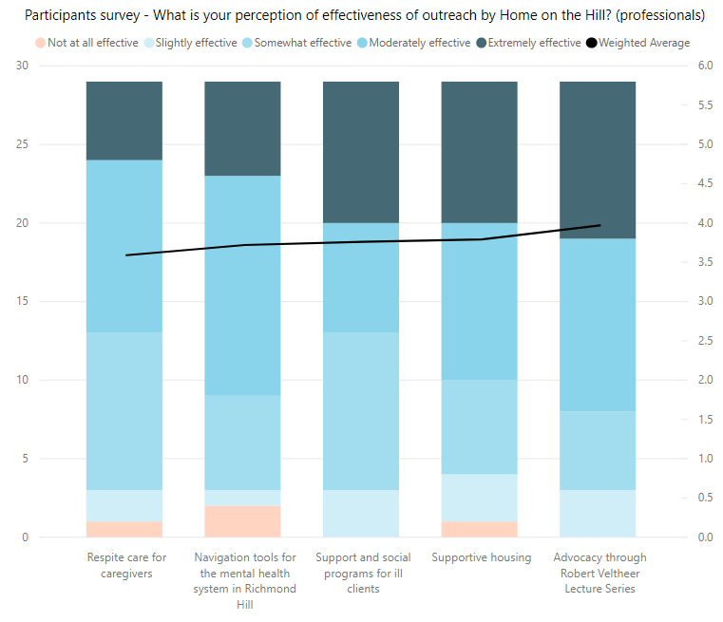
DATA FINDINGS
Perceptions of outreach by professionals
Unique value proposition in the Robert Veltheer Lectures
Recommendation
When we compared the Robert Veltheer Lecture survey data on ADHD to the wider participants survey, it was evident that the Robert Veltheer lectures provided a unique opportunity of asking experts in the field questions to which answers might be unavailable through other means. Therefore the Robert Veltheer Lectures offer a unique value proposition to attract people to Home on the Hill.

Slide 12
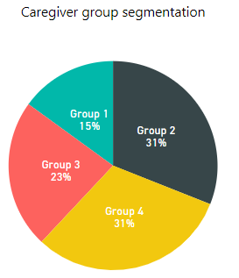
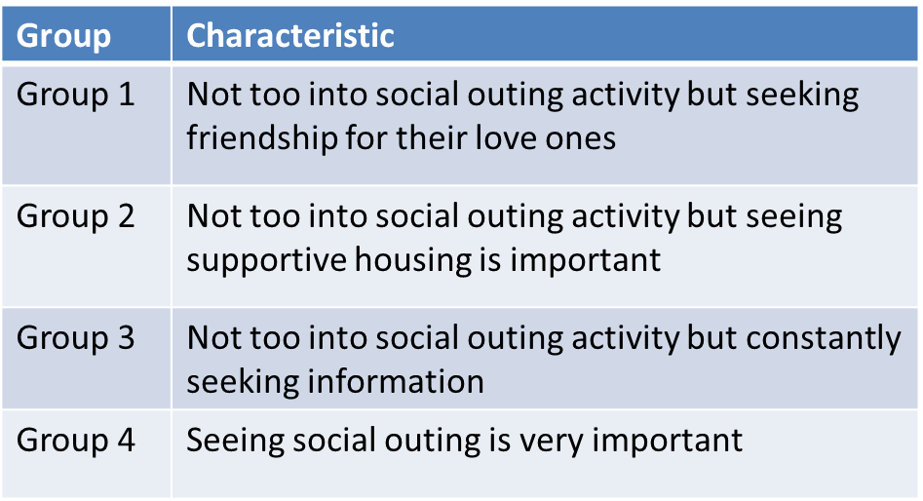
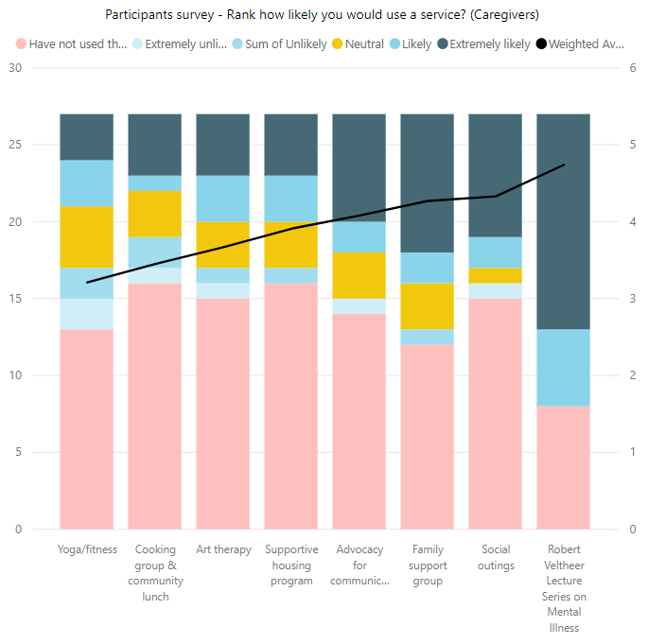
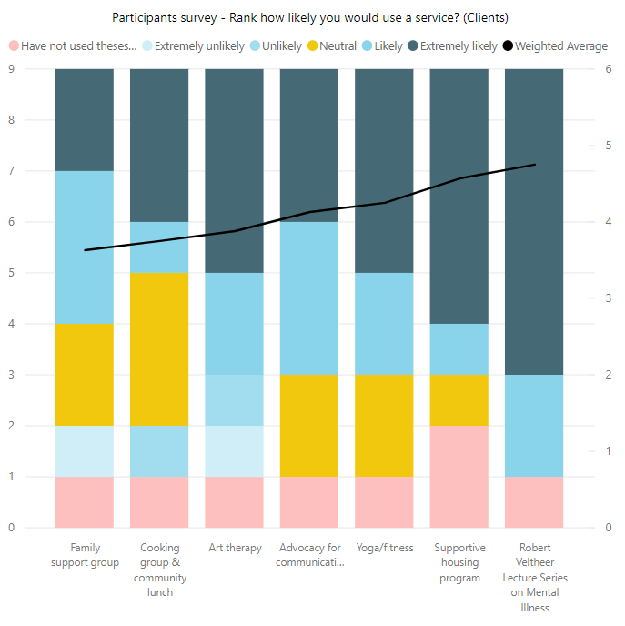
DATA FINDINGS
Perceived value of services – clients and caregivers
How to position supportive housing in relation to Robert Veltheer Lectures?
Survey analysis found that clients were more likely to attend Robert Veltheer lecture series rather than supportive housing (supportive housing ranked second).
Board member interviews ranked supportive housing as the least important strategic priority currently for HOH.
When asked about long-term and short-term vision of success for HOH, only 33% of the Board members mentioned supportive housing and interestingly that caregiver support / respite should be Home on the Hill’s top strategic priority. Perhaps this was a result of the Board Members perceiving that the Robert Lecture series are a core foundation of HOH and responding as to what HOH’s current strategic priority should be.
Further big data analysis revealed that most caregivers were seeking social outings and some felt that supportive housing was important (31%) and others were seeking information rather than social outing (23%). We conclude then that priorities for caregivers are social outing (1), supportive housing (2) and information (3).

Slide 13
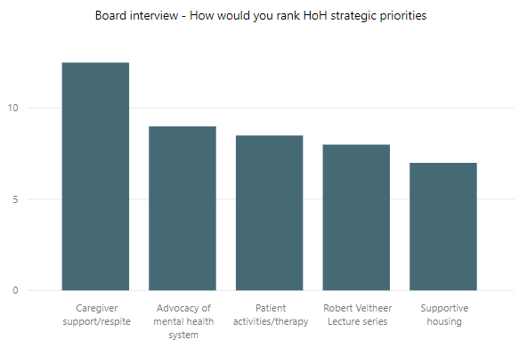
DATA FINDINGS
Perceptions of strategic priorities by the board
Obtaining alignment and coordination
Recommendation
The Board interviews indicated that caregiver support / respite should be Home on the Hill’s top strategic priority.
Competitive survey revealed that calls for mental health emergencies have been steadily increasing between 2010 to 2014 according to data available from York region. We extrapolate this finding to conclude that these numbers will continue to rise.
Therefore the board should align around the strategic goal of providing effective caregiver support and respite.
Source: https://www.york.ca/wps/wcm/connect/yorkpublic/

Slide 14
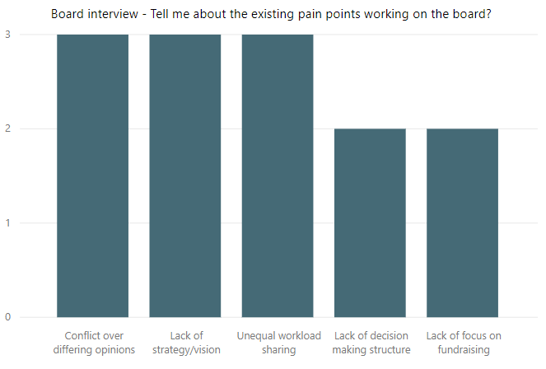
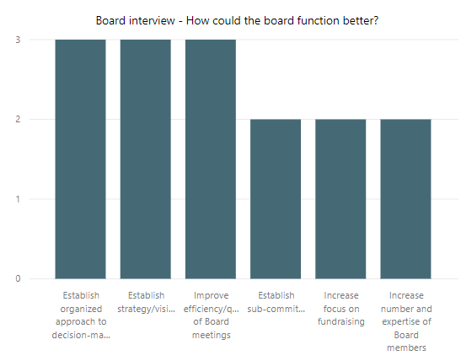
DATA FINDINGS
Perceptions of board efficiency
Identifying pain points and opportunities
Board interviews identified three main pain points:
1) Lack of alignment as to which strategic priorities to pursue
2) Lack of coordination in achieving the priorities (which though with great intentions, seem in conflict)
3) Unequal distribution of work and lack of consistent commitment to the board.

Slide 15
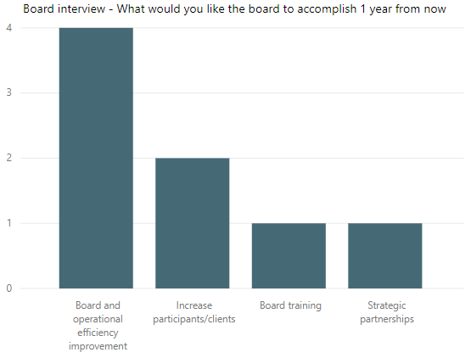
DATA FINDINGS
Perceptions of board efficiency
Identifying short term priorities
Recommendation
Board interviews suggest that priorities over the next year should include the following:
Document a skills-based inventory of each member and their time commitment, to understand how each member’s skills can be leveraged more effectively.
Design an organizational structure.
Create a document management system for easy access and retrieval of key organizational documents and information.
Establish an organized approach to decision-making – whose responsibility it is and associated metrics to review the decision, in an effort for a continuous cycle of process improvement.

Slide 16
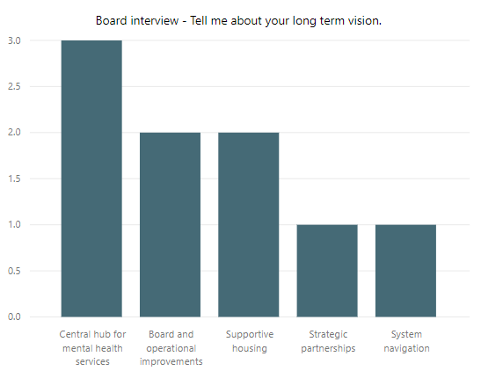
DATA FINDINGS
Perceptions of board efficiency
Identifying long term vision
Recommendation
Board interviews suggest that long term vision for Home on the hill should reflect the evolution of HOH into a central hub for non-medical mental health and educational support services for clients and their loved ones.

Slide 17
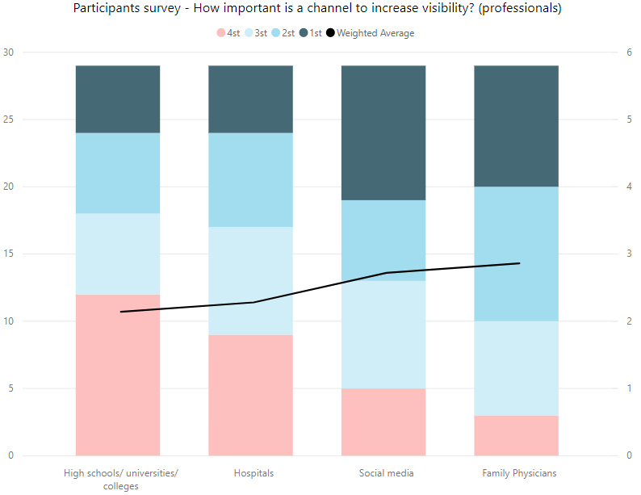
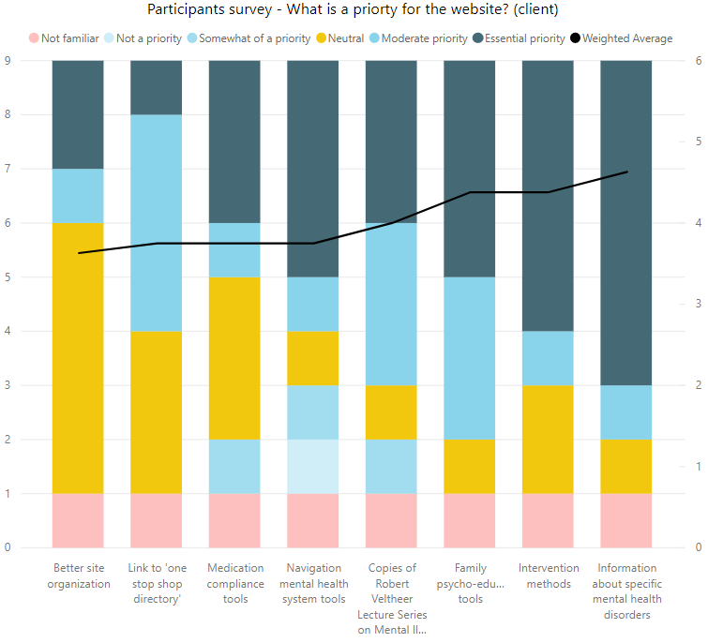
DATA FINDINGS
Visibility in the community
Effectiveness of communication channels
Recommendation
Survey findings of professionals indicated that social media was the most important channel to increase visibility of Home on the Hill followed by doctor’s offices.
From a website improvement perspective, survey findings indicated that there are key resources that would attract new participants to the website. They are:
Information on specific mental illnesses
Intervention methods
Family psycho-education tools
Means of navigating the mental health system

Slide 18
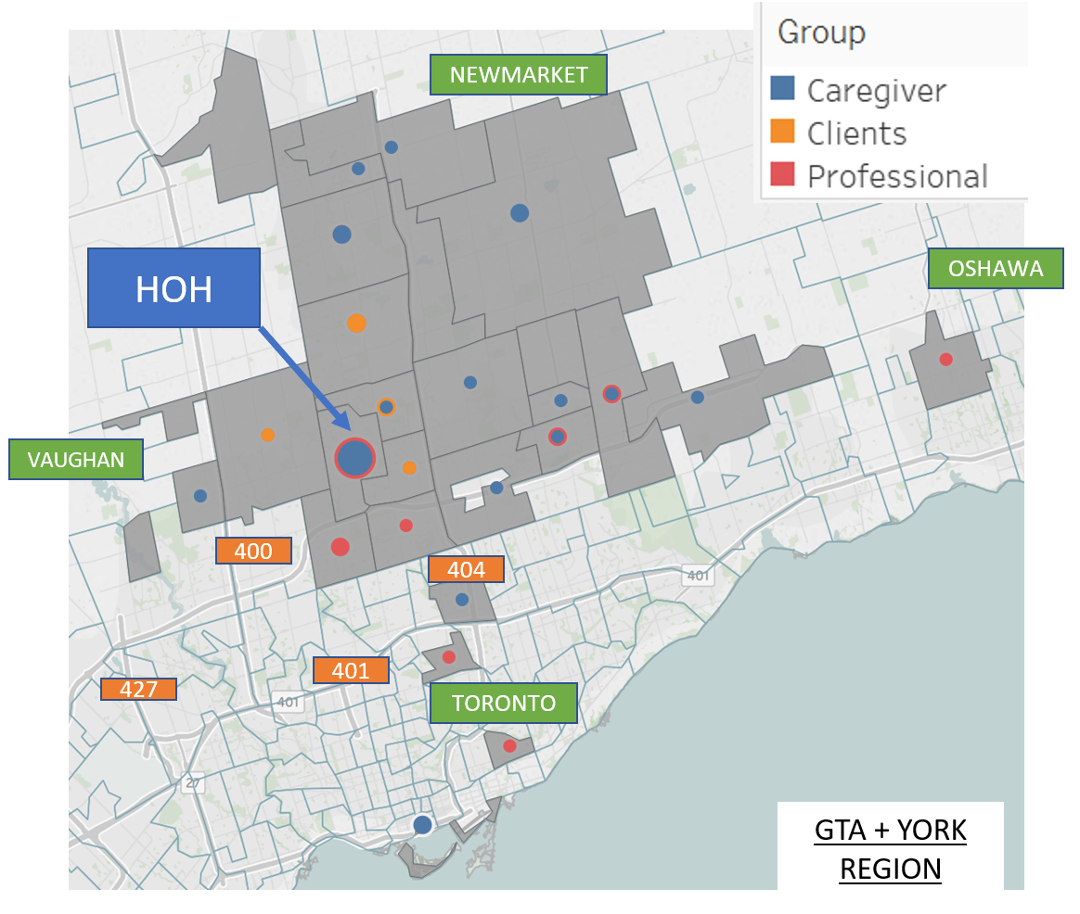
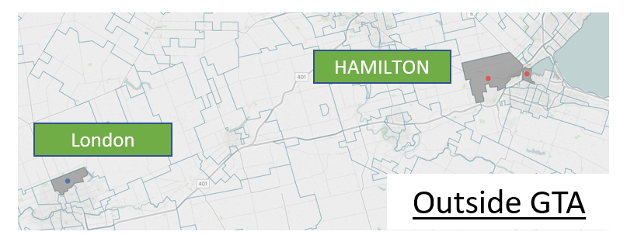
DATA FINDINGS
Geographic distribution
Segmentation analysis of the HOH community
Segmentation analysis of the survey participants indicated the following:
Survey caregivers were spread out and bounded by the York region.
Professionals were mostly in Toronto with some in Hamilton.

Slide 19
Strategic Recommendations

Slide 20
STRATEGIC RECOMMENDATIONS
High Level Strategic Summary
Focus the service offering
Supportive housing services as a long term strategic goal
Case management and recovery wellness as short term strategic goals
Robert Veltheer Lectures as a core competency
Attract participants
Leverage partnerships for strategic advantage
Leverage communication channels for broader reach and impact
Improve board efficiency
Design organizational structure of how a working board can operate effectively
Identify skills-based competencies and map to required resources
Establish metrics for impact

Slide 21
STRATEGIC RECOMMENDATIONS
Core Competencies
Analysis of HOH’s assets and skills: a way to think about assessing your limited resources and capabilities
HOH Core Competencies
HOH Assets
HOH Skills
HAS
DOES
Tangible
Intangible
Capabilities
1 supportive housing unit
Net Assets (2018): $32,608
Access to facilities to hold lectures (but no stable address)
Access to facilities to hold support programs (but no stable address)
Robert Veltheer’s legacy
Strong reputation through Robert Veltheer Lectures and opportunities for Q&A (that no one else offers)
Extensive personal networks and connections
Authentic positioning in personalizing clients’ needs
Respite care
Family support care
Patient support care
Education and advocacy through Robert Veltheer’s lectures
Art therapy and cooking

Slide 22
STRATEGIC RECOMMENDATIONS
Value net: differentiating yourselves in the community
Analysis of HOH’s positioning in the wider community: a way to think to improve your strategy
Patients
Caregivers
Professionals
LOFT/CrossLinks
BlueDoor Shelters
Regeneration Community Services
Parkview Manor Mental Health Facilities
Jay Kare Lodge
Heritage Lodge Mental Health Facility
Gordon’s Residential Home
Brookside Lodge
Good Shepherd Centres
Elizz Caregiving
Krasman Centre
Clients
HOH
Ontario Shores (clinical exchange of information for respite services)
Competitors for funding
Complementors for competitive advantage
Hospitals as suppliers
Trillium Health
Mackeznie Health
Markham Stoufville Hospital

Slide 23
STRATEGIC RECOMMENDATIONS
Providing Added Value in the Community
Evaluating competitors and complementors: creating added value – what can HOH offer that they don’t?
Organization Type | Potential Complementor, Partner or Competitor
 | Name | How do they complement us so that we can offer what they don’t have?
Health Centers | Krasman Centre | To offer joint unique programs, to share space, to advertise events to local community, Caregiver Programs could be enhanced by teaming up with Krasman Centre
 | Ontario Shores Centre for Mental Health Sciences | Ontario Shores specializes in Mental Health Sciences, a better opportunity to address common mental health needs. Also a mental health Education resource.
 | Southlake Regional Centre | Aurora (additional chapters in surrounding communities)
 | LOFT/Crosslinks Housing and Support Services | LOFT offers a range of services to a wide audience. Robert Veltheer Lecture series could be advertised. Case Management and Community Integration services could be leveraged
Health Professionals and Services | Mackenzie Health | Partnership with a local hospital would generate referrals to programs in demand. Would enable local visibility
 | Markham - Stouffville | Partnership good for long term growth and education of the local community.
Organizations (Local and Regional) | Canadian Mental Health Association CMHA | Programs offered are. MOBYSS – Mobile Walk in Clinic, Case Management Services. Partnerships could be formed for Family and Caregiver Group. For training Mental Health First Aid Basic (2-days) is offered by CMHA
 | Alzheimer Society of York Region | Partnerships for family caregiver programs or lecture series.
 | Belinda's Place | Belinda’s Place is women only organization, focused on transitional programs, case management, housing outreach.
 | Blue Door Shelters | Wide range of services offered and a large partner network
 | Elizz - All Things Caregiving | Strong expertise in Caregiving.
Online Resources | Online Support through Big White Wall https://www.ontarioshores.ca/ | A round-the-clock online peer support community where members can share experiences and express themselves in words and images, helping participants feel less socially isolated
 | CareGiver Exchange | An online platform for caregivers..

Slide 24
STRATEGIC RECOMMENDATIONS
Suggested Strategic Goals
Strategic goals enhance decision making by providing a unifying theme used to facilitate coordination. They are long term goals.
SG1
To be a leader in providing a support centre of customizable social supports and education for clients affected by severe mental health issues inclusive of their loved ones.
SG2
To be a leader in offering long term supportive housing for clients affected by severe mental health inclusive of their loved ones.

Slide 25
STRATEGIC RECOMMENDATIONS
Suggested Strategic Objectives
Strategic objectives are shorter term goals that align with your corresponding longer term strategic goals.
SO1
To obtain alignment as a working board and agree on clear roles and responsibilities. This will unlock your decision potential as an organization. This might look in the form of establishing sub-committees such as – fundraising, outreach, support programs, strategic planning. To focus each board meeting on strategic planning and review of metrics (what went well, what didn’t).
SO2
To adopt a growth mindset of continuous process improvement, as a working board and as an organization. Efficient and adopted processes will enable good use of limited resources which will translate into impressive outcomes – doing less with more.
SO3
To implement a framework in the form of a quarterly held lecture schedule (published in advance) to attract new participants to the Robert Veltheer Lecture Series on Mental Illness.
SO4
To organize “meet the professional” sessions immediately following the Robert Veltheer lectures where clients and caregivers could have longer informal Q&A sessions. This will enhance HOH’s core competence of education and thus, will differentiate the organization in the community.
SO5
To offer personalized client needs and track them through CMAP (Case Management Approach Plan). Purpose of this is to gather metrics on participants to measure effectiveness of program delivery. The need for programming structure was mentioned in the interviews, as well as in our competitive analysis.
To offer a means towards achieving personal accountability and empowerment through WRAP (Wellness Recovery Action Plan). WRAP is a self-managed recovery tool for helping clients prevent troubling feelings or behaviours, increase self-esteem and assist clients in achieving their life goals and improving quality of life. The need for wellness care was found in our competitive analysis and research.
SO6

Slide 26
STRATEGIC RECOMMENDATIONS
Suggested Performance Goals
Performance goals are metrics that will help assess effectiveness of your programs and are important criteria which will improve your credibility for securing funding in the longer term
To begin tracking the intake and participation of clients for the purposes of measuring program effectiveness through:
Client assessment
Client immediate needs
Client participation
Client management action plan
PG1
PG2
To encourage clients and/or caregivers towards managing self-care through:
Daily maintenance plans – description when you are well and what you need to maintain wellness
Triggers – if they happened, that would make you feel worse
Early warning signs – subtle signs that let you know you are beginning to feel worse
When things are breaking down – the signs that let you know you are feeling much worse
Crisis plan – signs that let your loved ones/caregivers know that you need immediate care and decision making
Post crisis plan

Slide 27
STRATEGIC RECOMMENDATIONS
Suggested (Revised) Vision, Mission and Principles
Addresses the organizational question – what do we want to be?
Commitments to ethical principles in how the organization achieves its stated strategic goals.
Vision
Principles
To facilitate systemic change in recognizing that mental health needs will never be addressed completely without the inclusion of families and friends who care for them.
To be authentic in empowering those we serve – different clients might have different needs.
To be engaging to foster a sense of community and integration.
To offer information transparently and balance it with a need for client and regulatory confidentiality.
To provide a respite environment for growing, learning and sharing.
Addresses organizational question of purpose – why do we exist?
Mission
To provide an inclusive circle of supportive care, education and respite for families and loved ones affected by serious mental illness living in the Richmond Hill community.

Slide 28
STRATEGIC RECOMMENDATIONS
Suggested Organizational Structure – Working Board
Designing an organizational structure divides work effort to operationalize your strategic objectives.
“Board of Directors”
Founder & CFO
Chief Operating Officer COO)
Fundraising Committee
Support Programs Committee – CMAP & WRAP
Lecture Series Committee
Art Therapy
Facilitator
Family Support/Respite
Yoga
Cooking
Music

Slide 29
Roadmap

Slide 30
ROADMAP
Suggested Roadmap: five steps!
Nudging you towards success!
Step 1
Step 2
Step 3
Step 4
Step 5
Believe in yourselves, commit to your goals with a growth mindset and set out to continuously improve!☺
Align strategic goals and objectives on the board.
Refine Robert Veltheer’s Lectures – enhance Q&A
Refine programming structure & metrics – consider CMAP & tracker.
Identify self-care needs for segments of clients and caregivers - consider WRAP & suggested forms

Slide 31

Questions?

